Slide 1

WESCO and the Unusual Rise of Modern India
May 2024
Marcellus Investment Managers Pvt. Ltd.
Marcellus’ staff, their relatives and Marcellus’ clients have beneficial interest in all the stocks mentioned in this presentation

Slide 2
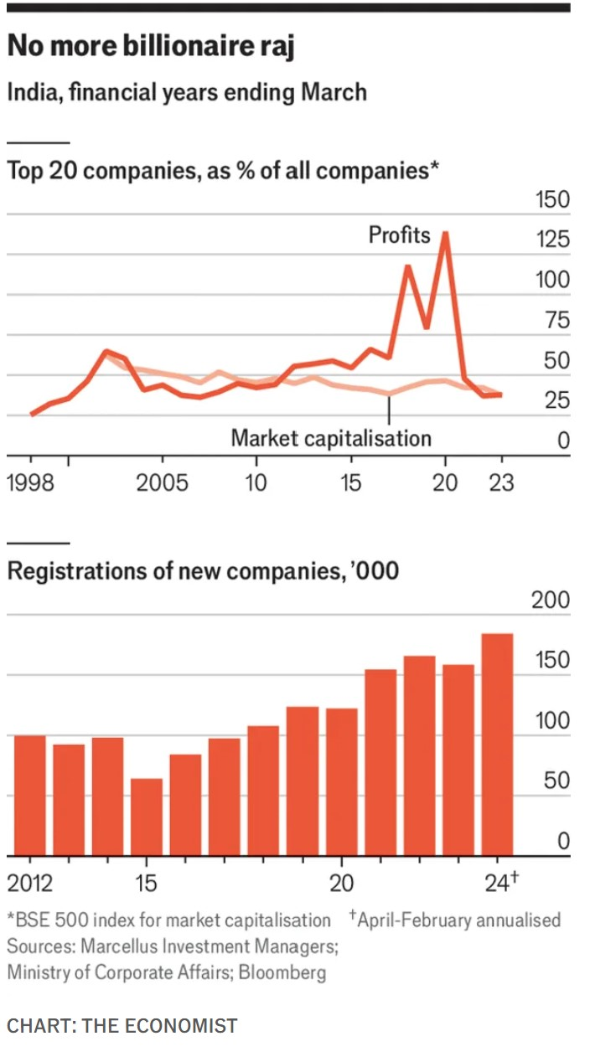
Profits are getting democratised in the Indian market…finally
3 drivers of the democratisation of profits
Steady buildup of India Stack and UPI
Greater access to credit for SMEs
Brand creation & marketing through social media
Source:Marcellus Investment Managers, CMIE (sourced by IIFL Securities), Bloomberg, Ace Equity; the CMIE data for FY23 pertains to nearly 12k companies, whose data has been updated on CMIE as opposed to the previous years when data for nearly 30k companies was used; Profit After Tax or PAT for top 20 has been checked for companies as of each of the financial years respectively; due to high variance in the measure, a 3 year average has been calculated to smoothen out any sudden movements; Free Cashflow to Equity (FCFE) has been calculated as cash flow from operations less capex plus net borrowing, whose 3 year average is calculated to smoothen out sharp movements; for financials, PAT instead of FCFE used

Slide 3
Key drivers of the democratization of profits
The Exponential Growth of UPI
Skyrocketing of loans to SMEs
Access to internet for 700mn+ people
Source: Marcellus Investment Managers, National Payments Corporation of India, RBI, Statista; the figure indicates % of population that has access to any kind of internet connection (cellular/broadband etc)

Slide 4
Five Megathemes are making their way into our portfolios
W
.
E
.
S
.
C
.
O
Women
Education
South
China+1
Octopus
Urban Indian Women Have More Money in the Bank Than Men
For the first time, people from non-IIT, non-IIM, non-foreign degrees run the majority of Nifty50 companies
Seven Southern states have per capita incomes 50% higher than the rest of the country
China’s Unravelling and Creation of a US$ 300 Billion per annum opportunity for India
Emergence of ~200K octopi families whose wealth has surged more than 16x in the last 20 years

Slide 5
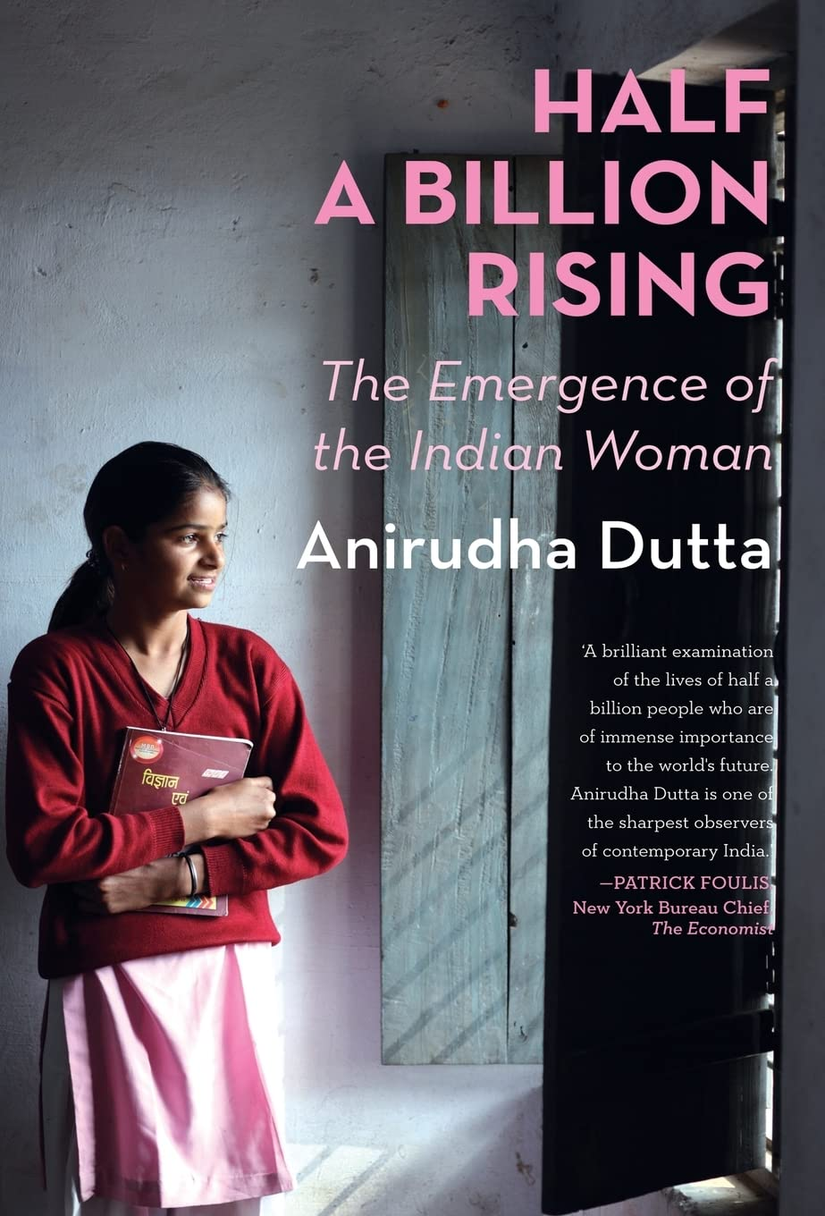



Urban Indian Women Have More Money in the Bank Than Men
More Indian women are getting educated than men.
Women’s pass rates are much higher than those of men.
Women are staying in the education system for longer than men.
On average, Urban Indian women have more money in their bank accounts than men (14% more in the metros).
Women in the tech industry earn on an average 7% more than men.
Source: Marcellus Investment Managers, National Statistics Office, MOSPI; metric used is average deposit or total deposit for men and women each divided by the number of accounts held by each gender, disaggregated by geography; see our blog on the subject here; Nestle, Trent, and Rainbow Hospitals are part of Marcellus portfolios; their mention here is illustrative and not recommendatory; Half a Billion Rising - Copyrights of above book is exclusively reserved with Author/Publisher of the above book; The Logos of the companies used in the presentation are the property of respective companies and we do not claim any rights of the above used logos.

Slide 6
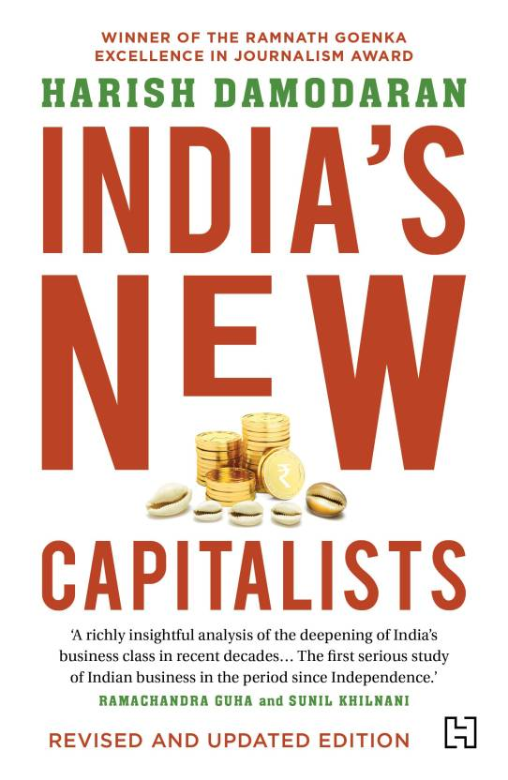




The Democratization of Opportunity in India’s Boardrooms
For the first time, the majority of the Directors of Nifty50 companies now have ‘normal’ Indian degrees (non-IIT, non-IIM and not educated abroad).
The old conglomerates run by elite families are steadily fading away; a new type of business leader is rising usually with a middle class non-elite upbringing.
Entrepreneurial drive, technological aptitude, and harnessing diverse talent pools are now crucial for success in modern India.
Source: Marcellus Investment Managers, company annual reports, Bloomberg; non-overlapping promoters and executive directors for FY03 identified using company annual reports; for FY13 and FY23 Bloomberg was used; Nifty 50 companies as of the respective financial years were used to build the list of promoters and executive directors; instances where the educational qualification data was not available were excluded from the analysis; totals may not seem to be 100% due to rounding; see our blog on the subject here; HDFC Bank, Astral, Mas financial services, and fine organics are part of multiple Marcellus portfolios; their mention here is illustrative and not recommendatory; India’s New Capitalists - Copyrights of above book is exclusively reserved with Author/Publisher of the above book; The Logos of the companies used in the presentation are the property of respective companies and we do not claim any rights of the above used logos..

Slide 7
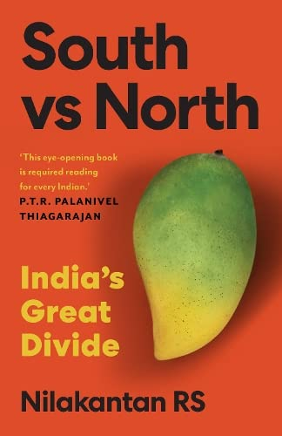




The Explosive Ascent of Southern India
Seven southern states’ (Tamil Nadu, Telangana, Andhra, Kerala, Karnataka, Goa, and Maharashtra) per capita income has grown at 10% p.a. CAGR in FY14-22.
The Southern Seven account for 30% of population, 45% of GDP and avg per capita income of ~$3.3K.
Southern Seven’s per capita income is 50% higher than rest of India’s; decade ago, it was 35% higher.
The Southern Seven account for 33% of Lok Sabha seats.
Source: Marcellus Investment Managers, Economic Survey of India 2022-23; 7 southern states identified as Telangana, Andhra, Maharashtra, Goa, Tamil Nadu, Kerala, and Karnataka; rest of India are all other states and union territories; due unavailability of data for many states in 2022-23, data is considered only until 2021-22; see our blog on the subject here; HDFC Bank, Asian Paints, Titan, and Trent are part of multiple Marcellus portfolios; their mention here is illustrative and not recommendatory ; South vs North - Copyrights of above book is exclusively reserved with Author/Publisher of the above book; The Logos of the companies used in the presentation are the property of respective companies and we do not claim any rights of the above used logos.

Slide 8





China’s Unravelling Creates a $300 billion opportunity for India
China’s economy has been pulverized due to the implosion of a massive real estate bubble, a beleaguered banking system, and a face off with America.
India, with its large skilled labor force, stands to gain from these developments.
Knowledge intensive manufactured products like smartphones, APIs, and medical devices could create a $300 bn per annum (10% of GDP) opportunity for India.
Global giants like Apple, Foxconn and Merck are proactively rewiring their supply chains away from China and towards India.
Source: Marcellus Investment Managers, company annual reports, Business Standard, Live Mint, Economic Times, CNBC, Grandview Research, IBEF, FrontiersIN. org, beroeinc.com, and EIN news; All values are in US$ bn; Chinese export shift assuming a fourth of their current exports shift to India over the next decade; World nominal GDP growth rate of 3.5% used to grow export shift for the next 10 years; Indian nominal GDP growth rate of 12% used to grow domestic production for the next 10 years; see our blog on the subject here; GMM Pfaudler, Alkyl Amines, Divis Labs, and Apple are part of multiple Marcellus portfolios; their mention here is illustrative and not recommendatory; The End of the World is Just the Beginning - Copyrights of above book is exclusively reserved with Author/Publisher of the above book; The Logos of the companies used in the presentation are the property of respective companies and we do not claim any rights of the above used logos.

Slide 9





The Octopus Ascends: The Rise of Crazy Rich Indians
Emergence of ~200K octopi families (or 1 million individuals) whose wealth has surged more than 16x in the last 20 years.
This is a result of the:
  Financialization of physical assets
  Networking of India throughs roads, air & internet
  Rise of highly paid executives
  Concentration of financial and political power.
‘Class’ consumption is growing much faster than ‘Mass’ consumption.
Source: Marcellus Investment Managers, incometaxindia.gov.in; HNW is defined as individuals earning >= 1 crore income p.a.; LNW is defined as individuals earning <= 10 lakhs p.a.; all the individuals earning between 10 lakh and 1 crore p.a. are classified as MNW; because of lack of detailed information available for FY23 at the time of writing this note, data only until FY22 has been considered; see our blog on the subject here; Titan, Eicher Motors, Kotak Bank, and Kering are part of multiple Marcellus portfolios; their mention here is illustrative and not recommendatory; The Billionaire Raj - Copyrights of above book is exclusively reserved with Author/Publisher of the above book; The Logos of the companies used in the presentation are the property of respective companies and we do not claim any rights of the above used logos.

Slide 10
Thank You!
10

Slide 11
Disclosures
Note: The above material is neither investment research, nor investment advice. Marcellus Investment Managers Private Limited (“Marcellus”) is regulated by the Securities and Exchange Board of India (“SEBI”) as a provider of Portfolio Management Services and an Alternative Investments Manager. Marcellus is also registered with US Securities and Exchange Commission (“US SEC”) as an Investment Advisor. Marcellus Investment Managers Private Limited (“Marcellus”) is regulated by the International Financial Service Centre Authority (Fund Management) Regulations, 2022 (“IFSCA”) as Fund Management Entity – Non retail. No content of this publication including the performance related information is verified by SEBI or US SEC. If any recipient or reader of this material is based outside India or US, please note that Marcellus may not be regulated in such jurisdiction and this material is not a solicitation to use Marcellus’s services. This communication is confidential and privileged and is directed to and for the use of the addressee only. The recipient, if not the addressee, should not use this material if erroneously received, and access and use of this material in any manner by anyone other than the addressee is unauthorized. If you are not the intended recipient, please notify the sender by return email and immediately destroy all copies of this message and any attachments and delete it from your computer system, permanently. No liability whatsoever is assumed by Marcellus as a result of the recipient or any other person relying upon the opinion unless otherwise agreed in writing. The recipient acknowledges that Marcellus may be unable to exercise control or ensure or guarantee the integrity of the text of the material/email message and the text is not warranted as to its completeness and accuracy. The material, names and branding of the investment style do not provide any impression or a claim that these products/strategies achieve the respective objectives. Marcellus and/or its associates, employees, the authors of this material (including their relatives) may have financial interest by way of investments in the companies covered in this material.
This material may contain confidential or proprietary information and user shall take prior written consent from Marcellus before any reproduction in any form.
Data/information used in the preparation of this material is dated and may or may not be relevant any time after the issuance of this material. Marcellus takes no responsibility of updating any data/information in this material from time to time. The recipient of this material is solely responsible for any action taken based on this material. The recipient of this material is urged to read the Private Placement Memorandum/Disclosure Document/Form ADV, Form CRS and any other documents or disclosures provided to them by Marcellus, as applicable, and is advised to consult their own legal and tax consultants/advisors before making any investment in the Alternative Investment Fund.
All recipients of this material must before dealing and or transacting in any of the products referred to in this material must make their own investigation, seek appropriate professional advice and carefully read the Private Placement Memorandum/Disclosure Document, Form ADV, Form CRS and any other documents or disclosures provided to them by Marcellus, as applicable. Actual results may differ materially from those suggested in this note due to risk or uncertainties associated with our expectations with respect to, but not limited to, exposure to market risks, general economic and political conditions in India and other countries globally, inflation, etc. There is no assurance or guarantee that the objectives of the investment strategy/approach will be achieved.
This material may include “forward looking statements”. All forward-looking statements involve risk and uncertainty. Any forward-looking statements contained in this document speak only as of the date on which they are made. Further, past performance is not indicative of future results. Marcellus and any of its directors, officers, employees and any other persons associated with this shall not be liable for any loss, damage of any nature, including but not limited to direct, indirect, punitive, special, exemplary, consequential, as also any loss of profit in any way arising from the use of this material in any manner whatsoever and shall not be liable for updating the document.
11

